Slide 1
Introducing functions
Python: Next steps
3rd Edition

Slide 2
Objectives
Understand what a procedure is
Be able to define and call a procedure
Understand why procedures are useful
Be able to use parameters in a procedure

Slide 3
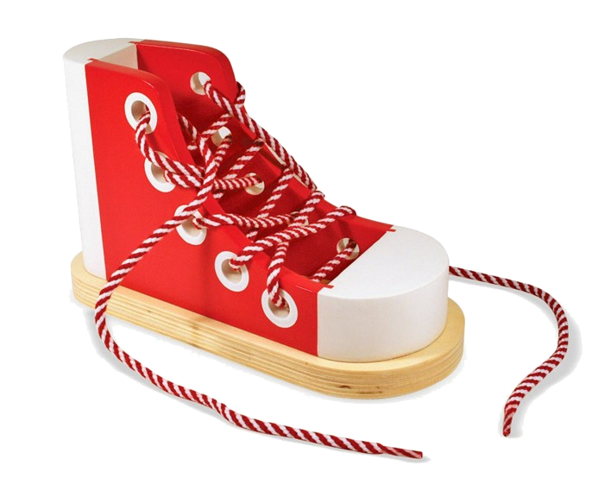
Starter
Write a set of instructions for tying your shoelaces

Slide 4
Procedures
You (probably) tie your shoelaces at least once a day. Are they tied now?
When you were young you will have been taught the steps and had to practise them
Now you just “tie your shoes” – this is a procedure

Slide 5
Procedures and functions
In some languages a procedure and a function are defined as two different types of subroutine or module
Python refers to both types as functions
A function is a named block of code that can perform an action whenever it is called

Slide 6
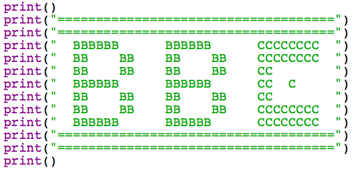
Re-using code
Download bbc.py and edit with IDLE
For each program, a BBC logo is displayed:

Slide 7
Defining a function
Instead of repeating the same code every time, we can shorten it to say “bbcLogo()”.
At the TOP of the program, add this code:
def bbcLogo():
Then cut and paste the code to print the BBC logo after the procedure definition (just like the statements inside an if statement)

Slide 8
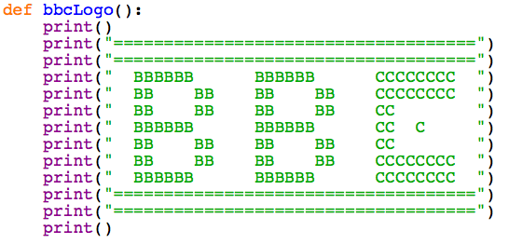
Defining a function
The code should look like this:
Make sure it is indented

Slide 9
Calling functions
To run a function you just use its name, followed by brackets
Take out the BBC logo lines just above the EastEnders section and type this code:
bbcLogo()

Slide 10
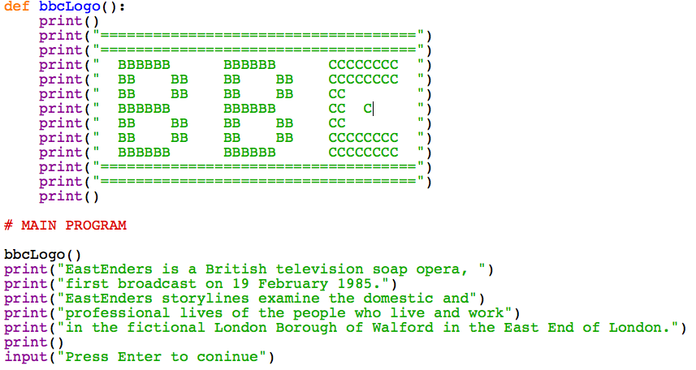
Calling functions

Slide 11
Calling functions
Repeat this for the other three sections:
Remove the 13 lines to print the BBC logo
Replace them with the code: bbcLogo()
Check that the program still runs in exactly the same way

Slide 12
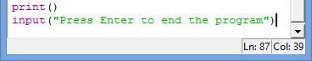
Advantages of functions
The original BBC program was 87 lines long
How long is your program now you have used a function for the BBC logo?
Can you think of any other advantages for using functions?

Slide 13
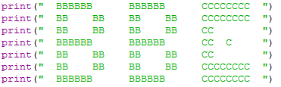
Advantages of functions
The BBC logo has a small mistake in it
The “C” has an extra letter in the middle
How many times would you have to fix this in the original program?
How many times do you need to fix it now?

Slide 14
Parameters
Sometimes when you run a function you just need to call it, for example:
tieYourShoes()
Sometimes you need to give a bit more information, for example:
lendMeSomeMoney(5)
lendMeSomeMoney(20)

Slide 15
Parameters
Try this code:
def printDouble(amount):
print("Double",amount, "is",amount*2)
printDouble(10)
printDouble(50)
printDouble(1862)

Slide 16

Now complete Worksheet 4

